Slide 1
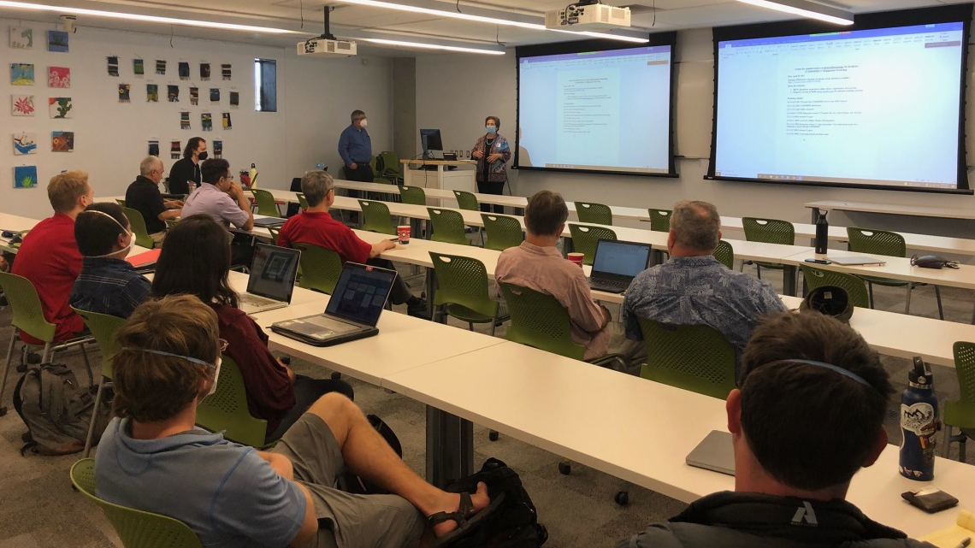
CAHS Workshop Summary
April 29th, 2022

Slide 2
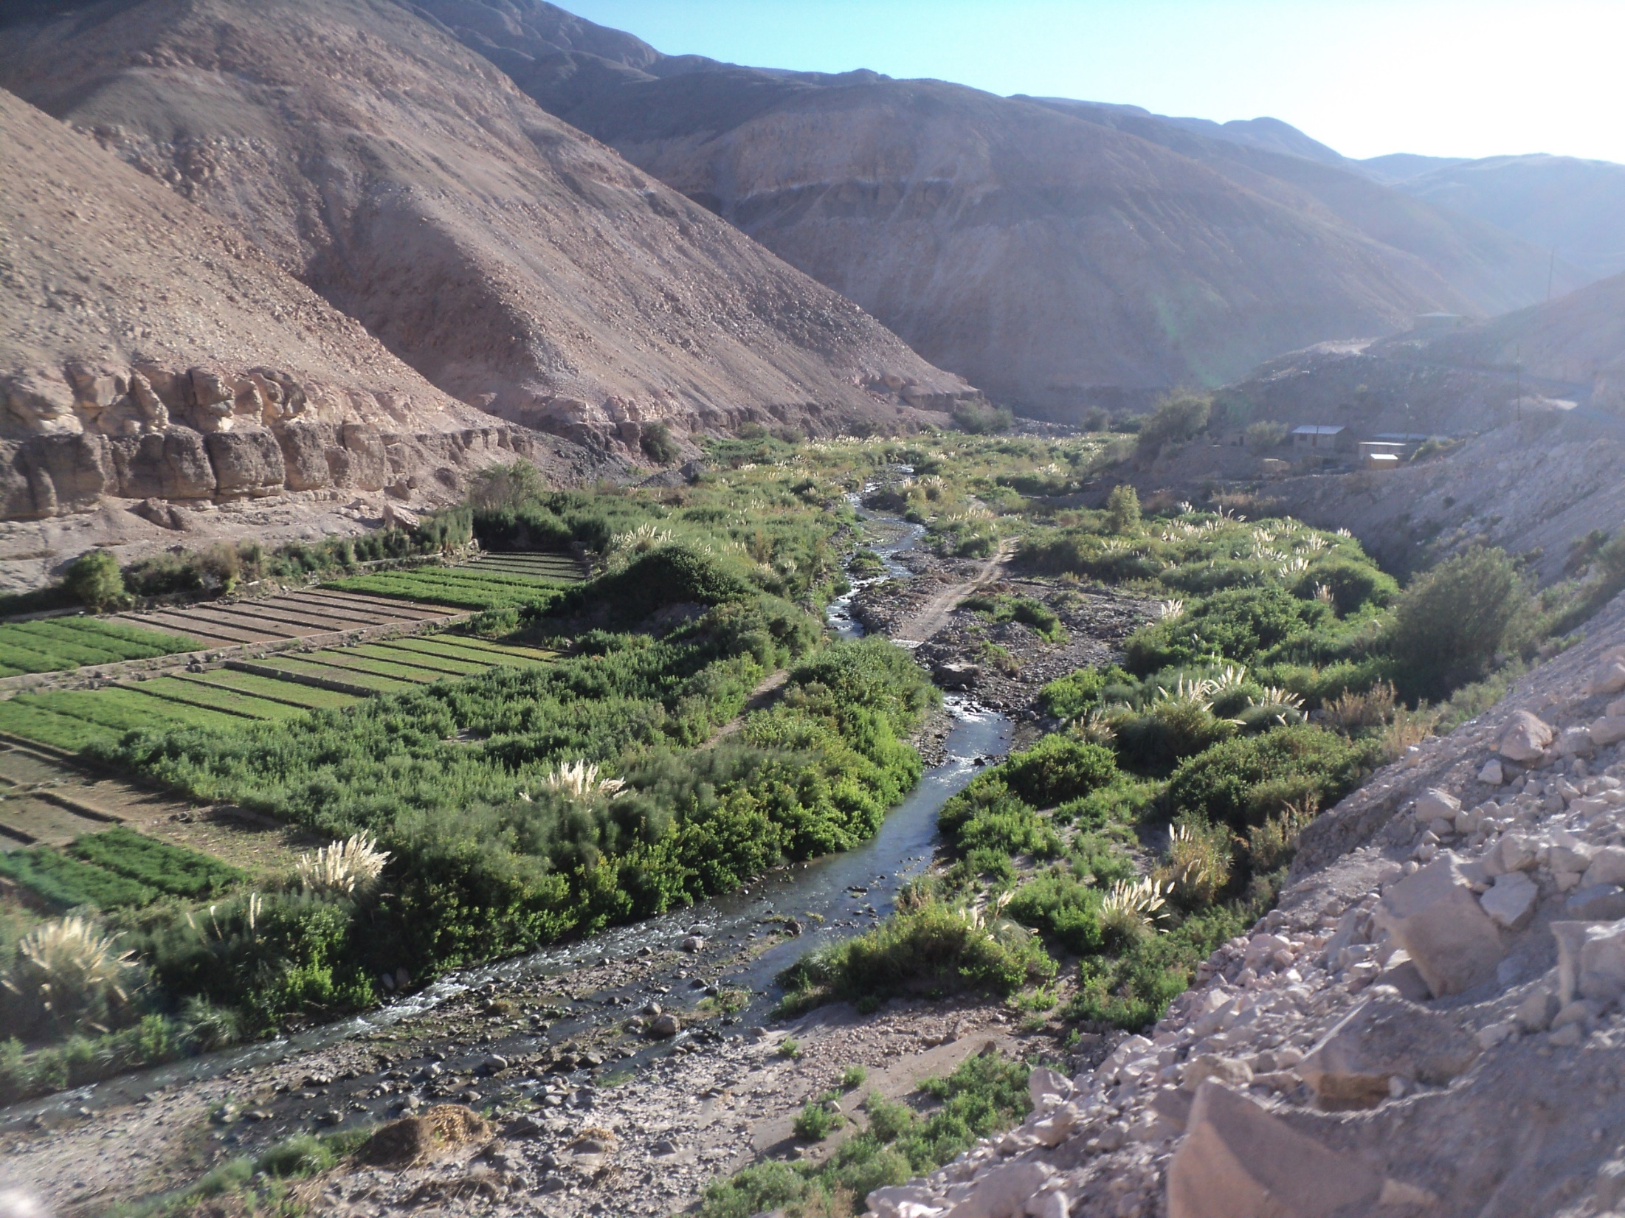
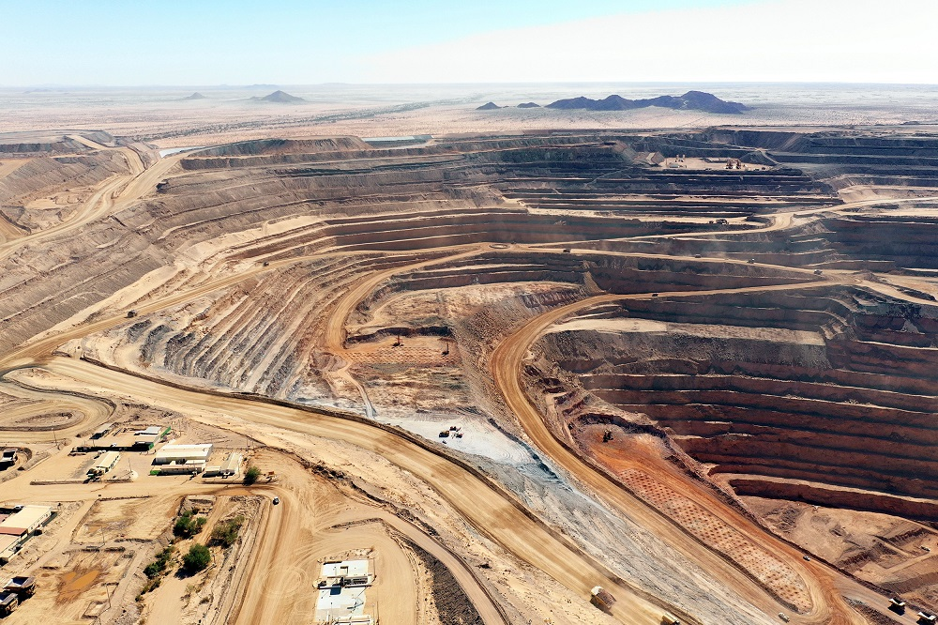
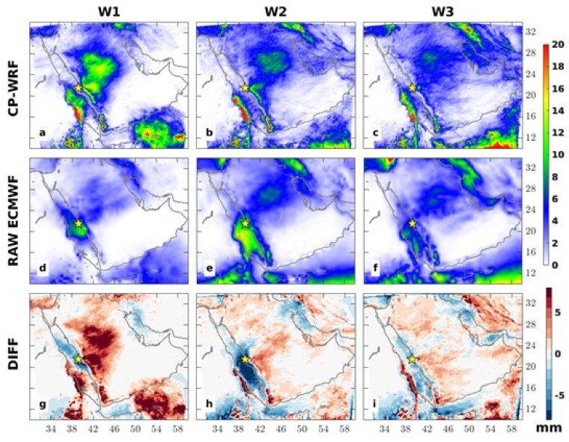
Center of Applied Hydroclimate Sciences (CAHS)
Vision: Apply hydrometeorological science to provide reliable information for decision making to increase resilience to environmental stresses.
Mission: Link hydrometeorological scientific knowledge and practice through modeling and by establishing paradigms for information generation and application.
Research
Services
Outreach
Student VIP and public education
Environmental and social resilience
Risk and vulnerability assessment
Decision support
Weather, climate and hydrology
Physics-and machine learning based modeling
Assessment of Processes and Tools
Weather, climate and water resources predictions
Science translation
Data Management and user training

Slide 3
Teams and partners
Climate Research Institutions
Hydrologic Research Center
Arizona Initiative for Resilience and International Development
Arizona Institutes for Resilience
Center for Western Weather and Water Extremes
Biosystems Engineering: Vegetation Index and Phenology Laboratory
Natural Resource Management
School of Geography and School of Government and Public Policy
School of Natural Resources and the Environment. Office of Arid Land Studies
Social Economical Sciences
Humanitarian Assistance Technical Support
Office of International Development
IRC and engagement of Tribes.
Public Health
University of Arizona One Health

Slide 4
Research thematic area
Applied Hydroclimate Sciences
Problem solving related to water
Climate Adaptation and Mitigation for Public and Private Sectors
Food security, Migration, Public Health, Disaster preparedness, Water resources
Climate projections for Southwest US
Sufficient spatial granularity
Socioeconomical Impact
Economical Translation of Environmental Risk Assessment
Climate data processing, ensemble climate projection
Climate Impact Metric
Effectiveness of adaptation

Slide 5
Federal grant opportunities
Target: Build connection with other States in different research areas (water and water management). Then go further to the Congress.
Federal agencies working with foreign governments: NASA, DOE, NOAA, etc.
Army and Airforce
Water Resource Management: Problem with water management in the Colorado River Basin (Colorado, California, Arizona, Nevada, and Mexico).
Non-federal grant opportunities
Non-profit foundations.
Corporate climate change assessment groups:
Economic escalation , Report assessment, Future's market
Politics: Include and consider national and international
Private Sector: mining, oil/gas, and insurance.
Founding routes

Slide 6
University of Arizona strengths
Climate downscaled data produced for regional climate change assessment.
Forecast verification
Climate information services
Capable of understanding climate related shocks and stresses to strengthen resilience capacities.

