Slide 1
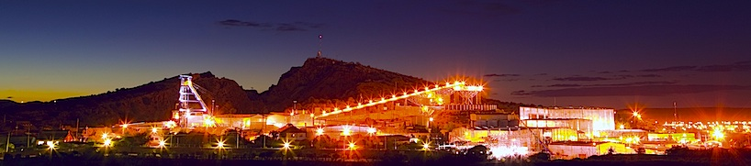



Fresnillo Mining and UA CAHS Collaboration

Slide 2
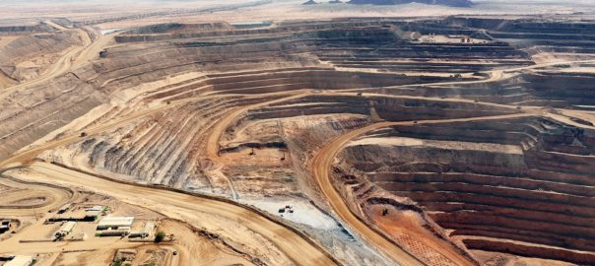

Climate services for mining industry
Motivation:
Climate change has different impacts on the mining life cycle: exploration, development, operation, closure and post-closure.
Actionable meteorological parameters are necessary to understand the risk, vulnerabilities and adaptation measures to protect the health and safety of Fresnillo personnel, build resilience of mining infrastructure (i.e. tailings storage facilities), secure water supply, and collaborate with neighboring communities.
Stakeholders of Fresnillo Mining expect a robust integration of climate change into their decision-making processes and financial planning.
Project tasks:
Climate assessment: For meteorological parameters near key mining sites, through physics-based regional climate modeling and statistics-based Weather Generator
Assess physical impacts of climate change and support cost-benefit analyses of adaptation measures.
Notes:
Climate projection data will be provided for the following variables of interest to Fresnillo:
Seasonal mean temperature: Summer, Winter
Annual minimum temperature
Annual maximum temperature
Annual precipitation
Extreme precipitation (Magnitude and Frequency)
Accumulated extreme precipitation
The first phase of the project will be conducted as a pilot on one Fresnillo mining site. A second phase will then apply the projection methods to the remaining four sites. The specific Fresnillo Mining sites are: Fresnillo, El Saucito, La Cienega, Penmont, and San Julian. The initial pilot site will be Penmont, as this location is physically nearest to Arizona

Slide 3
Fresnillo Mining:
Climate change adaptation approach
Vulnerability assessment
Adaptation pathways
Financial Disclosure (TCFD)
Climate Modelling
UA’s climate service is the driver for Fresnillo’s climate change adaptation
Critical for company infrastructure planning and insurance pricing risk
Notes:
Climate projection data will be provided for the following variables of interest to Fresnillo:
Seasonal mean temperature: Summer, Winter
Annual minimum temperature
Annual maximum temperature
Annual precipitation
Extreme precipitation (Magnitude and Frequency)
Accumulated extreme precipitation
The first phase of the project will be conducted as a pilot on one Fresnillo mining site. A second phase will then apply the projection methods to the remaining four sites. The specific Fresnillo Mining sites are: Fresnillo, El Saucito, La Cienega, Penmont, and San Julian. The initial pilot site will be Penmont, as this location is physically nearest to Arizona

Slide 4
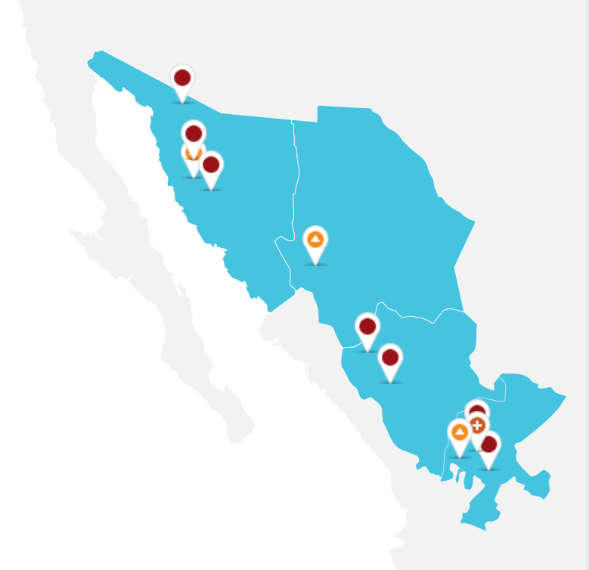
Fresnillo Mining:
Business Case
Fresnillo’s climate change strategy includes a decarbonization and an adaptation component
Reliable Climate Modelling is the cornerstone of our adaptation strategy.
Climate modelling supports the identification of vulnerabilities and the design of cost-effective adaptation pathways to protect our people, build resilience in Fresnillo’s infrastructure, collaborate with the communities and be transparent with the shareholders.
Fresnillo’s core operation sites for mining, development and exploration
Notes:
Climate projection data will be provided for the following variables of interest to Fresnillo:
Seasonal mean temperature: Summer, Winter
Annual minimum temperature
Annual maximum temperature
Annual precipitation
Extreme precipitation (Magnitude and Frequency)
Accumulated extreme precipitation
The first phase of the project will be conducted as a pilot on one Fresnillo mining site. A second phase will then apply the projection methods to the remaining four sites. The specific Fresnillo Mining sites are: Fresnillo, El Saucito, La Cienega, Penmont, and San Julian. The initial pilot site will be Penmont, as this location is physically nearest to Arizona

Slide 5
Climate service deliverables
Key variables of interest to Fresnillo Mining:
  Min/max temperature (Summer, Winter, Annual)
  Annual, monthly and extreme precipitation
  Max. annual and monthly evapotranspiration
  Solar radiation
  Wind speed and wind direction
Climate change assessment of the mining sites using a Weather Generator and downscaled regional climate projections
Notes:
Climate projection data will be provided for the following variables of interest to Fresnillo:
Seasonal mean temperature: Summer, Winter
Annual minimum temperature
Annual maximum temperature
Annual precipitation
Extreme precipitation (Magnitude and Frequency)
Accumulated extreme precipitation
The first phase of the project will be conducted as a pilot on one Fresnillo mining site. A second phase will then apply the projection methods to the remaining four sites. The specific Fresnillo Mining sites are: Fresnillo, El Saucito, La Cienega, Penmont, and San Julian. The initial pilot site will be Penmont, as this location is physically nearest to Arizona

Slide 6
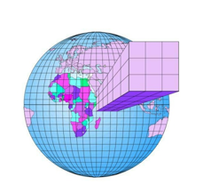
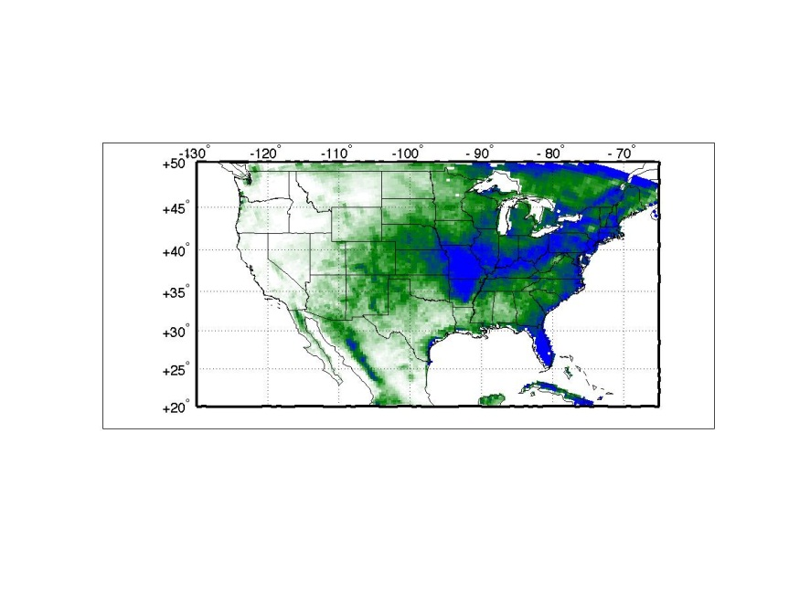
Process of climate assessment through physics- and statistics-based climate downscaling data:
Global Climate Data
IPCC CMIP5 and CMIP6
Downscaled Climate Data
Statistical & dynamical downscaling
Weather Generator
Statistical climate projection informed by the specific meteorological data at mining sites
Notes:
Climate projection data will be provided for the following variables of interest to Fresnillo:
Seasonal mean temperature: Summer, Winter
Annual minimum temperature
Annual maximum temperature
Annual precipitation
Extreme precipitation (Magnitude and Frequency)
Accumulated extreme precipitation
The first phase of the project will be conducted as a pilot on one Fresnillo mining site. A second phase will then apply the projection methods to the remaining four sites. The specific Fresnillo Mining sites are: Fresnillo, El Saucito, La Cienega, Penmont, and San Julian. The initial pilot site will be Penmont, as this location is physically nearest to Arizona

Slide 7
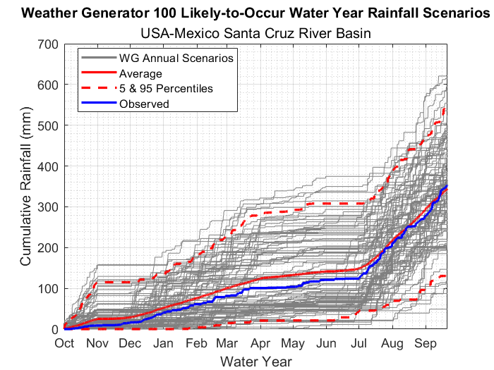
Weather Generator
A stochastic model that represents key features of the meteorological data
Produces ‘likely to occur’ scenarios of precipitation and temperature
A sufficiently large number of likely to occur scenarios represents the region’s natural variability and uncertainty associated with the observed records
The probabilistic nature of the WG output is used to assess the risk and impact of changes
﻿Rainfall scenarios generated by the WG
(based on historic record of the Santa Cruz River near the USA-Mexico border)

Slide 8
Example of climate change assessment in a prior research project
Bureau of Reclamation Lower Santa Cruz River Basin Study

Slide 9
Fresnillo-UA collaboration
Climate adaptation in mining is a relatively new field! Finding the right knowledge partners, most notably on climate modelling, is key to develop a robust adaptation strategy
The University of Arizona and Fresnillo have a longstanding collaboration with flagship projects on ethics culture, diversity, equity and inclusion.
This collaboration is set to conduct a scientifically rigorous climate modelling exercise to support engineering, operations, health, safety, environment and community teams in designing adaptation pathways.
The education mindset of the University of Arizona has been crucial to introduce Fresnillo to climate modelling.
This collaboration aims to reach out to universities and mining companies in Mexico to extend the use of climate modelling to support adaptation strategies
Notes:
Climate projection data will be provided for the following variables of interest to Fresnillo:
Seasonal mean temperature: Summer, Winter
Annual minimum temperature
Annual maximum temperature
Annual precipitation
Extreme precipitation (Magnitude and Frequency)
Accumulated extreme precipitation
The first phase of the project will be conducted as a pilot on one Fresnillo mining site. A second phase will then apply the projection methods to the remaining four sites. The specific Fresnillo Mining sites are: Fresnillo, El Saucito, La Cienega, Penmont, and San Julian. The initial pilot site will be Penmont, as this location is physically nearest to Arizona

